Slide 1

My Dream Job
This Photo by Unknown Author is licensed under CC BY

Slide 2

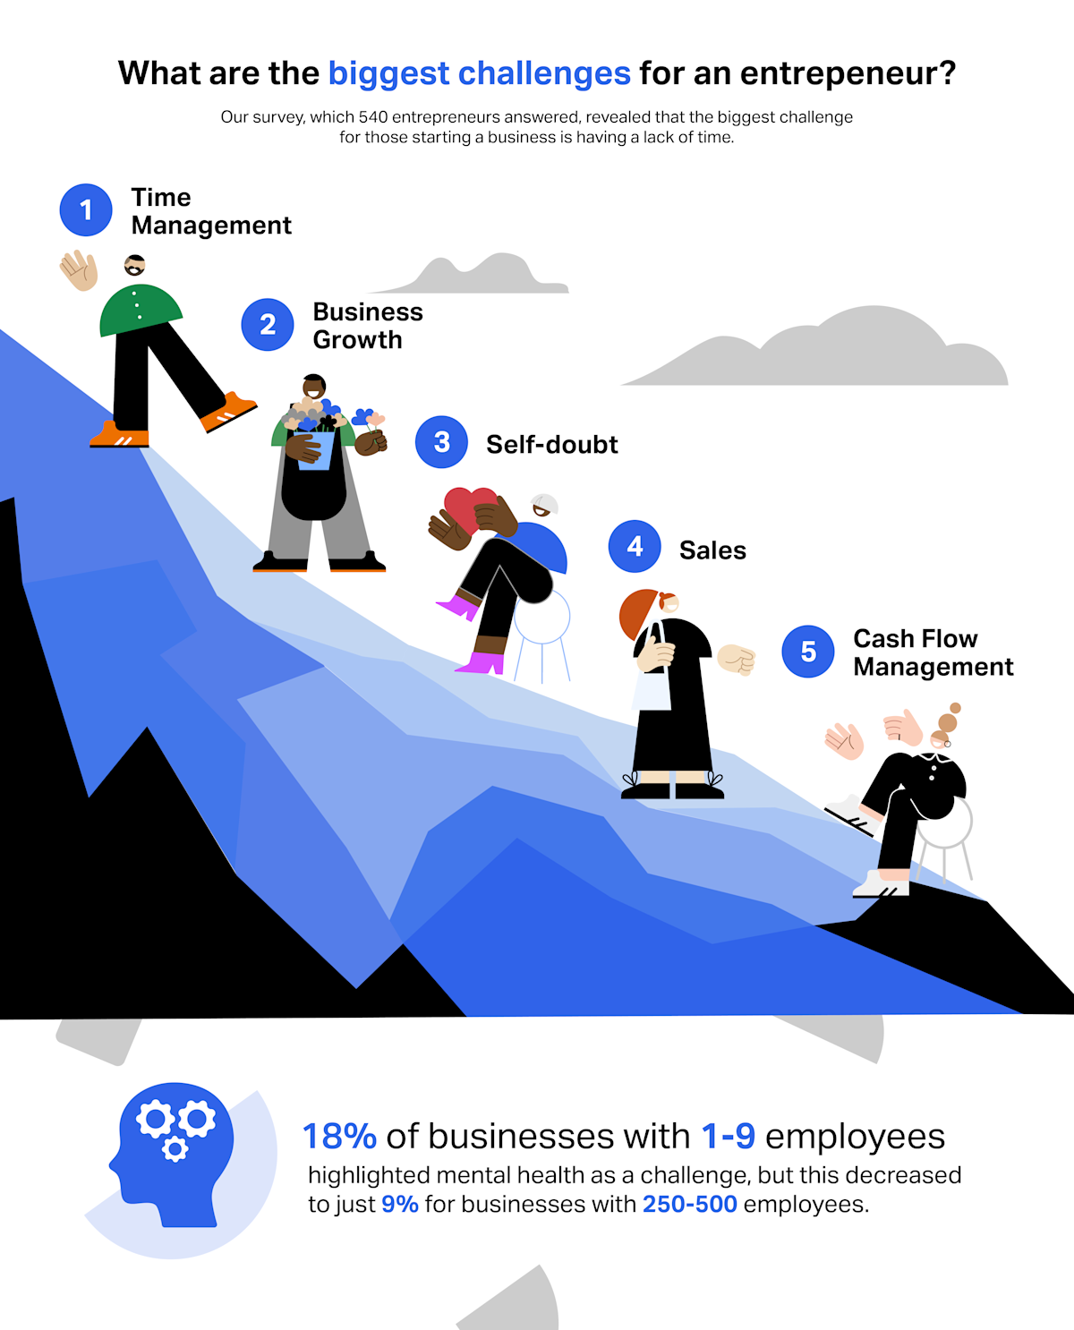
Entrepreneurship
Entrepreneurs create, run, and grow businesses.
Their main job is to turn ideas into something useful that people are will to pay for.

Slide 3

What Entrepreneurs Actually Do
Find Opportunities
They look for problems in the society and find solutions.
Example , noticing people need affordable food ; starting a food business.
Start Businesses
They turn ideas into real businesses by;
Planning
Getting resources (money, materials)
Setting up operations

Slide 4

Market and sell
Entrepreneurs promote their products.
Advertising on social media (WhatsApp or Facebook)
Talking to customers
Building a brand
Manage Money
They manage finances;
Budgeting
Saving Profits
Reinvesting into the Business
This Photo by Unknown Author is licensed under CC BY-NC-ND

Slide 5
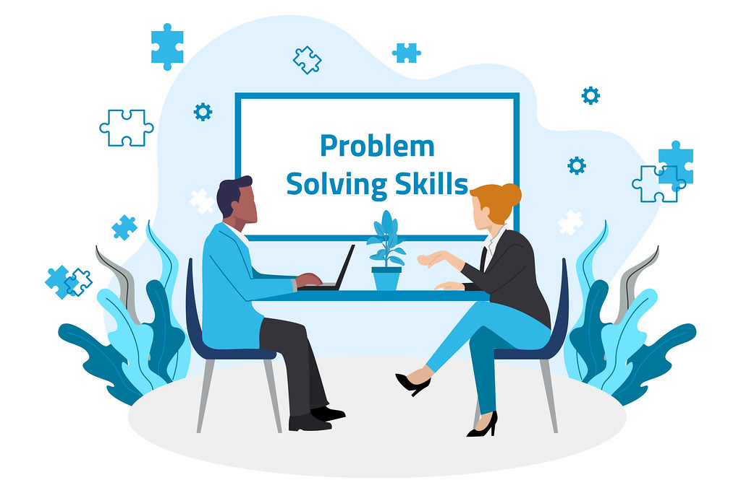
In short
Entrepreneurs;
Solve problems
Start businesses
Make money
Create jobs
This Photo by Unknown Author is licensed under CC BY

Slide 6

Skills Entrepreneurs Need
Communication skills
Problem-solving
Time management
Leadership skills
Discipline and Consistency
Creativity and Innovation
Risk-Taking and Courage
This Photo by Unknown Author is licensed under CC BY-SA

Slide 7

Bonus Skills
Basic Computer Skills
Social media marketing
Savings and investing habits
This Photo by Unknown Author is licensed under CC BY-NC

Slide 8
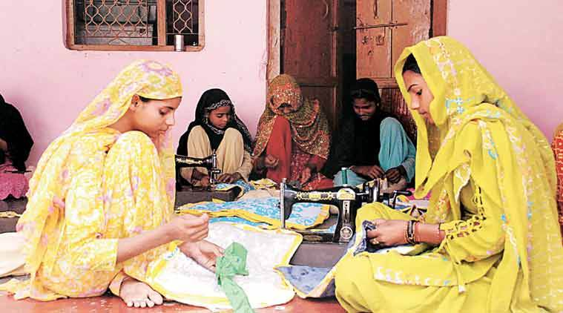
However
It doesn’t have a fixed amount you can earn.
It depends on the kind of business one does , the efforts and how successful it becomes.
This Photo by Unknown Author is licensed under CC BY

Slide 9

Where Do Entrepreneurs work?
Entrepreneurs don’t have a fixed place for work, they can work anywhere, depending on the type of business they are doing.

Slide 10
What Appeals About Entrepreneurship
Freedom and Independence
Turning ideas into reality
Unlimited income potential
Making an impact

